Slide 1
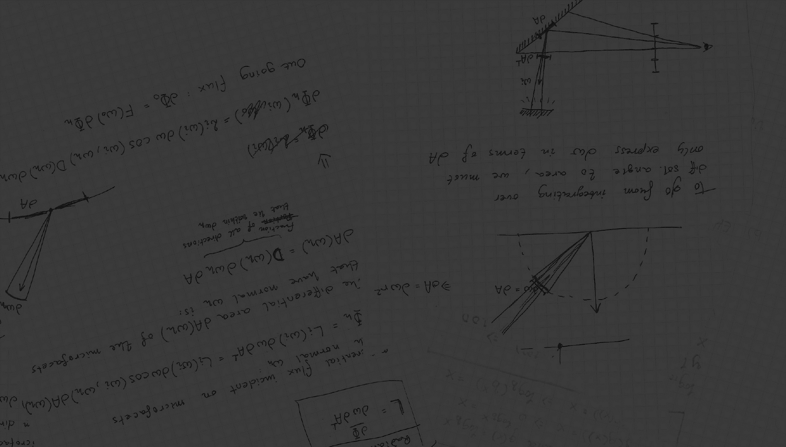
Light Transport
Advanced Computer Graphics 2017
Erik Sintorn

Slide 2
Before we start:
Remember to choose a subject for your presentation soon.
And your project.
Student representatives:
  JOHAN BACKMAN johback@student.chalmers.se
  KEVIN BJÖRKLUND kevinb@student.chalmers.se
  JONAS HULTÉN jonashu@student.chalmers.se
  HAMPUS LIDIN lidin@student.chalmers.se
  VICTOR OLAUSSON vicola@student.chalmers.se
  Come for a quick talk with me during recess.
Muddy Cards!

Slide 3
Light Transport Simulation
Rendering an image is a matter of ”simulating” how light propagates through a virtual scene and lands on a virtual camera film.
Many algorithms exist, and the best one depends on many factors.
For a long time, Photon Mapping and Irradiance Caching were extremely popular.
  Trade correctness for speed.
  Will cover these only very briefly.

Slide 4
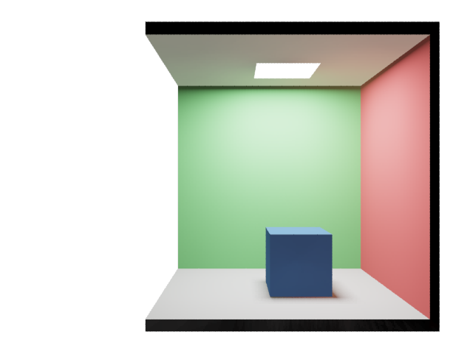
Photon Mapping
Pinhole Camera

Slide 5
Irradiance Caching
Pinhole Camera

Slide 6
Path Tracing
Path tracing is an algorithm for rendering images.
  Introduced by James Kajiya in 1986 as a numerical solution to the Rendering Equation.
  The algorithm is convergent and unbiased.
  Has long been considered too noisy/slow to be used in industry.
Today, almost all commercial renderers use some form of unbiased pathtracing (at least optionally).
  Pixar (for example) only switched completely very recently.
Why the sudden popularity?

Slide 7
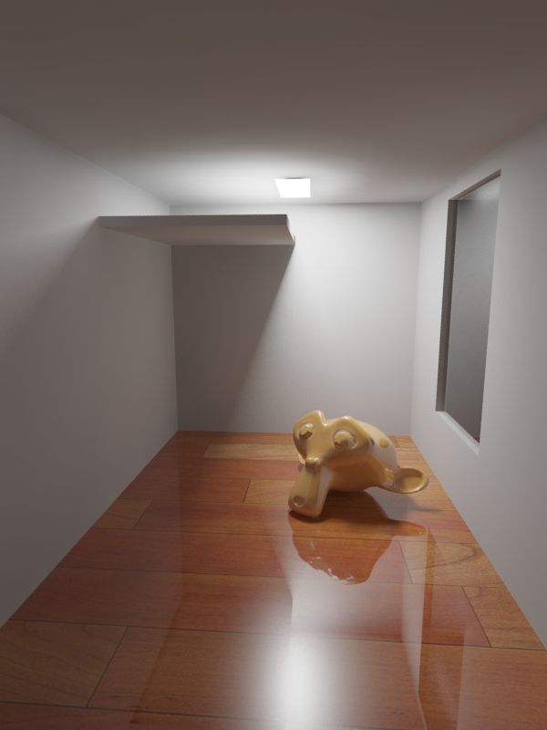
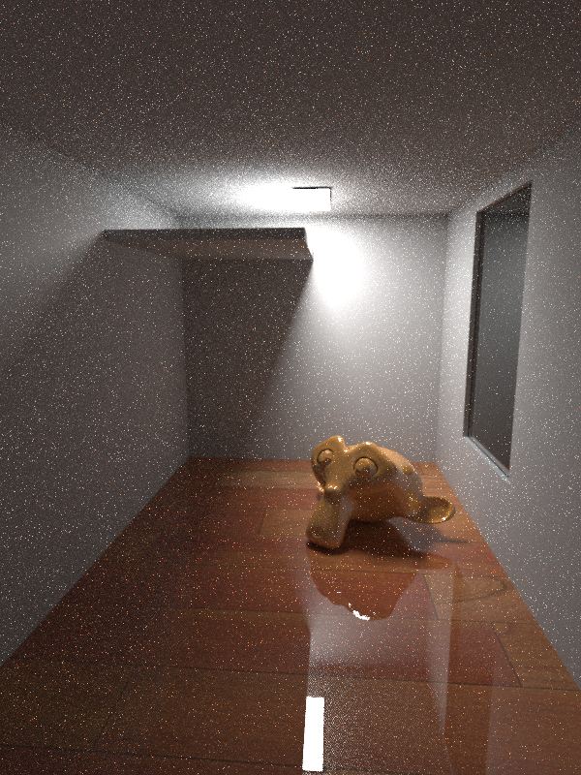
Mental Ray (photon mapping) 32s
iRay (path tracing) 32s

Slide 8
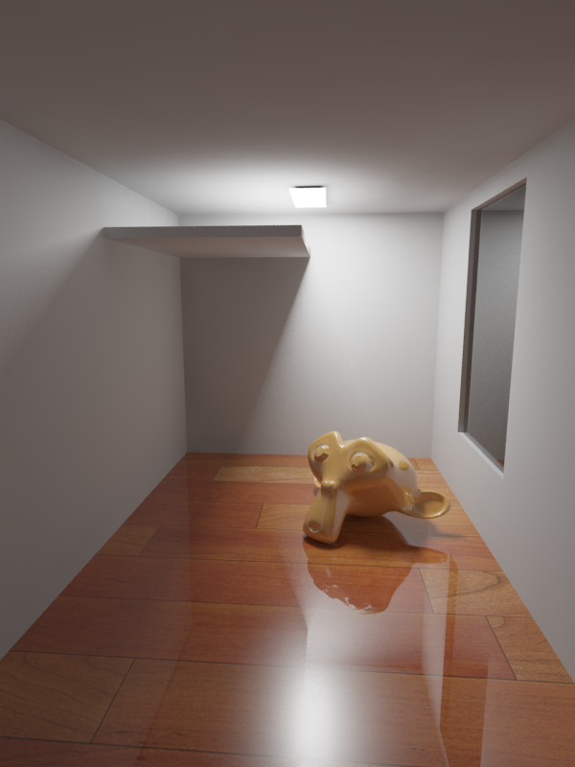

Mental Ray (photon mapping) 2m8s
iRay (path tracing) 2m8s

Slide 9

Mental Ray (photon mapping) 2m8s
iRay (path tracing) 2m8s
iRay (path tracing) ~1h

Slide 10
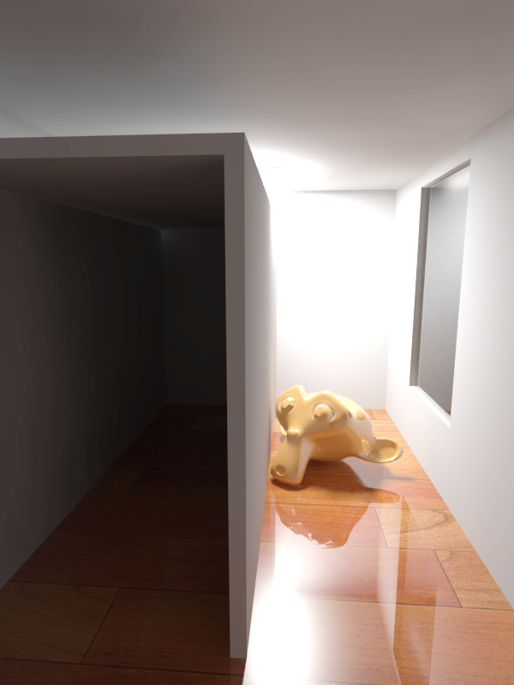
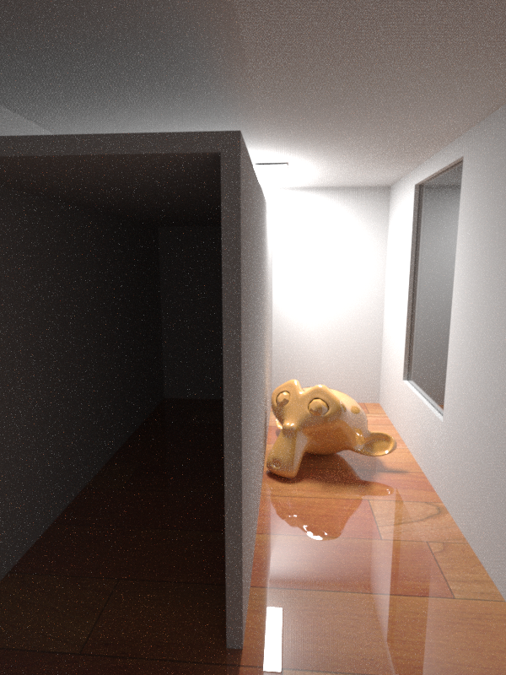
Mental Ray 15m, 100M Photons, FG 1.0
iRay (path tracing) 15m
Artifacts never go away
Scene specific tuning choices
Immediate response
Much easier to parallelize

Slide 11
Where does an image come from?
Pinhole Camera

Slide 12
Where does an image come from?
Photon emitted
From some random point on the light.
Carries some energy E
Flies in some random direction.
Pinhole Camera

Slide 13
Where does an image come from?
Pinhole Camera
Hits a surface
Some of the energy of some
frequencies is absorbed.
The rest is reflected in some direction

Slide 14
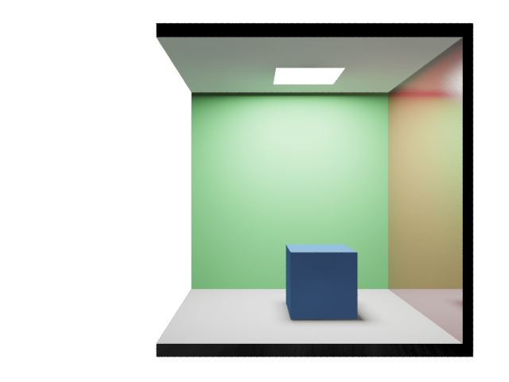
Where does an image come from?
Pinhole Camera

Slide 15
Where does an image come from?
Pinhole Camera
Keeps bouncing on surfaces
Loosing energy at each hit

Slide 16
Where does an image come from?
Until it leaves the scene…
Or just runs out of energy
Pinhole Camera

Slide 17
Where does an image come from?
Or happens to hit our film
Pinhole Camera

Slide 18






Light Transport Equation
Radiance:
$$W/{(m}^{2}sr)$$
$L_{o}\left(p,ω\right)$?
$$p$$
$$ω$$
$$L_{o}\left(p,ω\right)=L_{e}\left(p,ω\right)+\int_{Ω}{f\left(p,ω,ω^{′}\right)L_{i}\left(p,ω^{′}\right)\cos\left(n,ω^{′}\right)dω′}$$

Slide 19


Light Transport Equation
$$ω$$
$$p$$
Reflected radiance
Emitted radiance
$$L_{o}\left(p,ω\right)=L_{e}\left(p,ω\right)+\int_{Ω}{f\left(p,ω,ω^{′}\right)L_{i}\left(p,ω^{′}\right)\cos\left(n,ω^{′}\right)dω′}$$

Slide 20
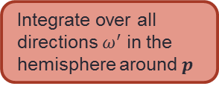


Light Transport Equation
Integrate over all directions $ω^{′}$ in the hemisphere around $p$
$$ω′$$
$$ω$$
$$p$$
Reflected radiance
Emitted radiance
$$L_{o}\left(p,ω\right)=L_{e}\left(p,ω\right)+\int_{Ω}{f\left(p,ω,ω^{′}\right)L_{i}\left(p,ω^{′}\right)\cos\left(n,ω^{′}\right)dω′}$$

Slide 21

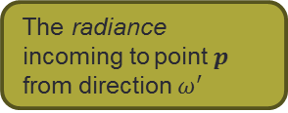
Light Transport Equation
Integrate over all directions $ω^{′}$ in the hemisphere around $p$
The radiance incoming to point $p$ from direction $ω^{′}$
$$L_{i}\left(p,ω^{′}\right)$$
$$ω′$$
$$ω$$
$$p$$
Reflected radiance
Emitted radiance
$$L_{o}\left(p,ω\right)=L_{e}\left(p,ω\right)+\int_{Ω}{f\left(p,ω,ω^{′}\right)L_{i}\left(p,ω^{′}\right)\cos\left(n,ω^{′}\right)dω′}$$

Slide 22







Light Transport Equation
Convert between irradiance parallel to $ω$ and irradiance on surface.
$$\cos\left(n,ω^{′}\right)$$
$$n$$
Integrate over all directions $ω^{′}$ in the hemisphere around $p$
$$ω^{′}$$
$$α$$
The radiance incoming to point $p$ from direction $ω^{′}$
$$α$$
$$1m^{2}$$
$$L_{i}\left(p,ω^{′}\right)$$
$$ω′$$
$$ω$$
$$p$$
Reflected radiance
Emitted radiance
$$L_{o}\left(p,ω\right)=L_{e}\left(p,ω\right)+\int_{Ω}{f\left(p,ω,ω^{′}\right)L_{i}\left(p,ω^{′}\right)\cos\left(n,ω^{′}\right)dω′}$$

Slide 23


Light Transport Equation
Convert between irradiance parallel to $ω′$ and irradiance on surface.
$$\cos\left(n,ω^{′}\right)$$
$$n$$
Integrate over all directions $ω^{′}$ in the hemisphere around $p$
$$ω^{′}$$
$$α$$
The radiance incoming to point $p$ from direction $ω^{′}$
$$α$$
$$1m^{2}$$
$$L_{i}\left(p,ω^{′}\right)$$
The BRDF tells us the differential outgoing radiance in direction $ω$ due to irradiance on surface.
$$ω′$$
$$ω$$
$$p$$
Reflected radiance
Emitted radiance
$$L_{o}\left(p,ω\right)=L_{e}\left(p,ω\right)+\int_{Ω}{f\left(p,ω,ω^{′}\right)L_{i}\left(p,ω^{′}\right)\cos\left(n,ω^{′}\right)dω′}$$

Slide 24



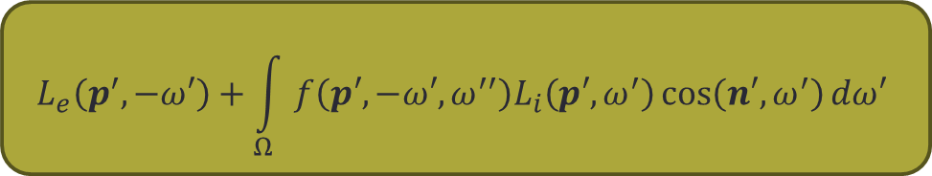



Light Transport Equation
$$p′$$
$$L_{i}\left(p,ω^{′}\right)$$
$$=$$
$$L_{o}\left(p^{′},−ω^{′}\right)$$
$$−ω′$$
$$ω′$$
$$L_{e}\left(p^{′},−ω′\right)+\int_{Ω}{f\left(p′,−ω′,ω^{′′}\right)L_{i}\left(p′,ω^{′}\right)\cos\left(n′,ω^{′}\right)dω′}$$
$$=$$
$$ω$$
$$p$$
Reflected radiance
Emitted radiance
$$L_{o}\left(p,ω\right)=L_{e}\left(p,ω\right)+\int_{Ω}{f\left(p,ω,ω^{′}\right)L_{i}\left(p,ω^{′}\right)\cos\left(n,ω^{′}\right)dω′}$$

Slide 25
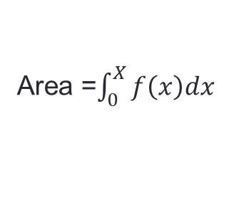



Numerical Integration
4
$$\frac{X}{N}$$
Area =$\int_{0}^{X}{f\left(x\right)dx}$
$$f(x)$$
0
0
$$x$$
X

Slide 26
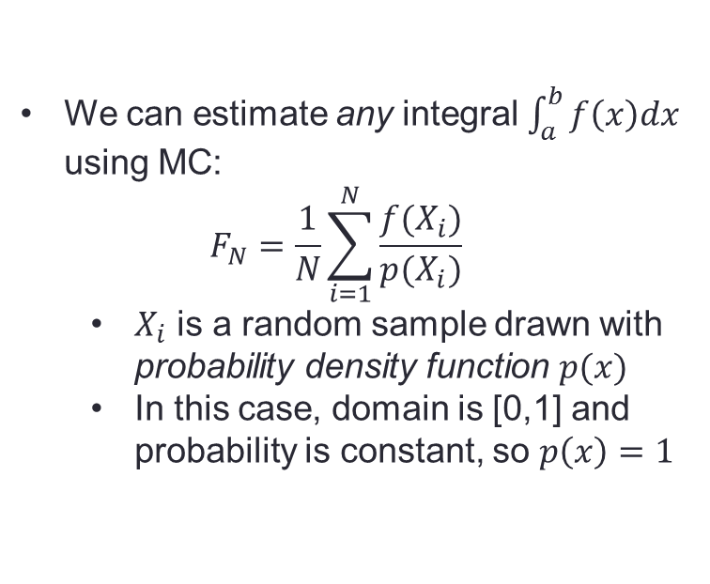
Monte Carlo Integration
We can estimate any integral $\int_{a}^{b}{f\left(x\right)dx}$ using MC:
$F_{N}=\frac{1}{N}\sum_{i=1}^{N}{\frac{f(X_{i})}{p(X_{i})}}$
  $X_{i}$ is a random sample drawn with probability density function $p(x)$
  In this case, domain is [0,1] and probability is constant, so $p\left(x\right)=1$
4
Area =$\int_{0}^{X}{f\left(x\right)dx}$
0
0
1.0

Slide 27
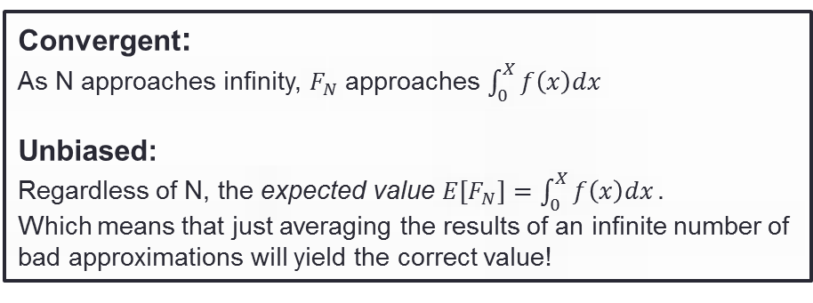



Monte Carlo Integration
$$F_{N}=\frac{1}{N}\sum_{i=1}^{N}{\frac{f(X_{i})}{p(X_{i})}}=\frac{1}{1}1.8$$
4
Convergent:
As N approaches infinity, $F_{N}$ approaches $\int_{0}^{X}{f\left(x\right)dx}$
Unbiased:
Regardless of N, the expected value ${E[F}_{N}]=\int_{0}^{X}{f\left(x\right)dx}.$
Which means that just averaging the results of an infinite number of
bad approximations will yield the correct value!
$$f\left(X_{1}\right)=1.8$$
Area =$\int_{0}^{X}{f\left(x\right)dx}$
0
0
$X_{1}=0.2$7
1.0

Slide 28


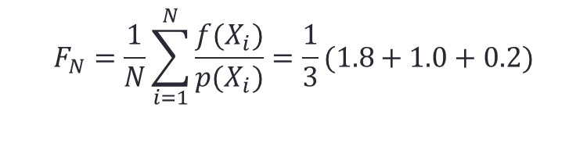



Monte Carlo Integration
$$F_{N}=\frac{1}{N}\sum_{i=1}^{N}{\frac{f(X_{i})}{p(X_{i})}}=\frac{1}{3}(1.8+1.0+0.2)$$
4
$$f\left(X_{1}\right)=1.8$$
$$f\left(X_{2}\right)=1.0$$
Area =$\int_{0}^{X}{f\left(x\right)dx}$
$$f\left(X_{3}\right)=0.2$$
0
0
$X_{2}=0.$05
$X_{1}=0.2$7
$X_{3}=0.$8
1.0

Slide 29

Monte Carlo Integration
$$F_{N}=\frac{1}{N}\sum_{i=1}^{N}{\frac{f(X_{i})}{p(X_{i})}}=…$$
4
0
Area =$\int_{0}^{X}{f\left(x\right)dx}$
0
0
1.0

Slide 30
Monte Carlo Integration
$$F_{N}=\frac{1}{N}\sum_{i=1}^{N}{\frac{f(X_{i})}{p(X_{i})}}=…$$
4
4
Area =$\int_{0}^{X}{f\left(x\right)dx}$
0
0
1.0

Slide 31

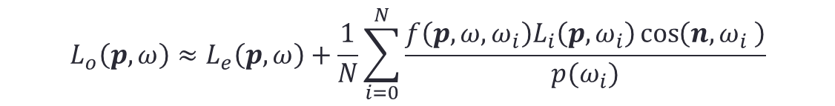
Monte Carlo Integration
Reflected radiance
Emitted radiance
$$L_{o}\left(p,ω\right)=L_{e}\left(p,ω\right)+\int_{Ω}{f\left(p,ω,ω^{′}\right)L_{i}\left(p,ω^{′}\right)\cos\left(n,ω^{′}\right)dω′}$$
$$L_{o}\left(p,ω\right)≈L_{e}\left(p,ω\right)+\frac{1}{N}\sum_{i=0}^{N}{\frac{f\left(p,ω,ω_{i}\right)L_{i}\left(p,ω_{i}\right)\cos\left(n,ω_{i} \right)}{p(ω_{i})}}$$

Slide 32
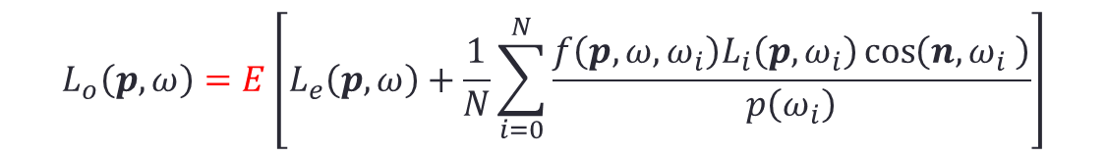
Monte Carlo Integration
$$L_{o}\left(p,ω\right)=E\left[L_{e}\left(p,ω\right)+\frac{1}{N}\sum_{i=0}^{N}{\frac{f\left(p,ω,ω_{i}\right)L_{i}\left(p,ω_{i}\right)\cos\left(n,ω_{i} \right)}{p\left(ω_{i}\right)}}\right]$$

Slide 33


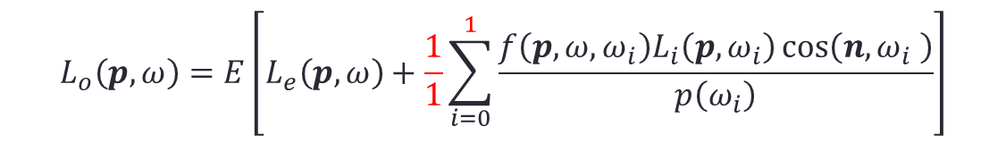
Monte Carlo Integration
Sample hemisphere
uniformly :
$p\left(ω_{i}\right)= \frac{1}{2π}$
$$L_{o}\left(p,ω\right)=E\left[L_{e}\left(p,ω\right)+\frac{1}{1}\sum_{i=0}^{1}{\frac{f\left(p,ω,ω_{i}\right)L_{i}\left(p,ω_{i}\right)\cos\left(n,ω_{i} \right)}{p\left(ω_{i}\right)}}\right]$$
$$L_{o}\left(p,ω\right)=E\left[L_{e}\left(p,ω\right)+\frac{f\left(p,ω,ω_{i}\right)L_{i}\left(p,ω_{i}\right)\cos\left(n,ω_{i} \right)}{p\left(ω_{i}\right)}\right]$$

Slide 34
Monte Carlo Integration
Sample hemisphere
uniformly :
$p\left(ω_{i}\right)= \frac{1}{2π}$
$$L_{o}\left(p,ω\right)=E\left[L_{e}\left(p,ω\right)+2πf\left(p,ω,ω_{i}\right)L_{i}\left(p,ω_{i}\right)\cos\left(n,ω_{i} \right)\right]$$

Slide 35
Naive Pathtracing
$$p$$
$$L_{o}\left(p,ω\right)≈L_{e}\left(p,ω\right)+2πf\left(p,ω,ω_{i}\right)L_{i}\left(p,ω_{i}\right)\cos\left(n,ω_{i} \right)$$
$$L_{o}\left(p,ω\right)≈L_{e}\left(p,ω\right)+2πf\left(p,ω,ω_{i}\right)L_{i}\left(p,ω_{i}\right)\cos\left(n,ω_{i} \right)$$

Slide 36

Naive Pathtracing
$$ω_{i}$$
$$p$$
$$L_{o}\left(p,ω\right)≈L_{e}\left(p,ω\right)+2πf\left(p,ω,ω_{i}\right)L_{i}\left(p,ω_{i}\right)\cos\left(n,ω_{i} \right)$$
$$L_{o}\left(p,ω\right)≈L_{e}\left(p,ω\right)+2πf\left(p,ω,ω_{i}\right)L_{i}\left(p,ω_{i}\right)\cos\left(n,ω_{i} \right)$$
$$L_{o}\left(p,ω\right)≈L_{e}\left(p,ω\right)+2πf\left(p,ω,ω_{i}\right)L_{i}\left(p,ω_{i}\right)\cos\left(n,ω_{i} \right)$$

Slide 37
Naive Pathtracing
$$ω_{i}$$
$$p$$
$$L_{o}\left(p,ω\right)≈0+2πf\left(p,ω,ω_{i}\right)L_{i}\left(p,ω_{i}\right)\cos\left(n,ω_{i} \right)$$

Slide 38

Naive Pathtracing
$$p′$$
$$ω_{i}$$
$$p$$
$$L_{o}\left(p,ω\right)≈0+2πf\left(p,ω,ω_{i}\right)L_{o}\left(p′,{−ω}_{i}\right)\cos\left(n,ω_{i} \right)$$
$$L_{o}\left(p,ω\right)≈0+2πf\left(p,ω,ω_{i}\right)L_{i}\left(p,ω_{i}\right)\cos\left(n,ω_{i} \right)$$

Slide 39
Naive Pathtracing
$$p′$$
$$ω_{i}$$
$$p$$
$$L_{o}\left(p,ω\right)≈0+2πf\left(p,ω,ω_{i}\right)\left[L_{e}\left(p^{′},−ω_{i}\right)+2πf\left(p^{′},−ω_{i},ω_{j}\right)L_{i}\left(p′,ω_{j}\right)\cos\left(n′,ω_{j} \right)\right]\cos\left(n,ω_{i} \right)$$

Slide 40

Naive Pathtracing
$$ω_{j}$$
$$p′$$
$$ω_{i}$$
$$p$$
$$L_{o}\left(p,ω\right)≈0+2πf\left(p,ω,ω_{i}\right)\left[0+2πf\left(p^{′},−ω_{i},ω_{j}\right)L_{i}\left(p′,ω_{j}\right)\cos\left(n′,ω_{j} \right)\right]\cos\left(n,ω_{i} \right)$$

Slide 41

Naive Pathtracing
$$p′$$
$$ω_{j}$$
$$p′$$
$$ω_{i}$$
$$p$$
$$L_{o}\left(p,ω\right)≈0+2πf\left(p,ω,ω_{i}\right)\left[0+2πf\left(p^{′},−ω_{i},ω_{j}\right)L_{i}\left(p′,ω_{j}\right)\cos\left(n′,ω_{j} \right)\right]\cos\left(n,ω_{i} \right)$$

Slide 42

Naive Pathtracing
$$p′′$$
$$ω_{j}$$
$$p′$$
$$ω_{i}$$
$$p$$
$$L_{o}\left(p,ω\right)≈0+2πf\left(p,ω,ω_{i}\right)\left[0+2πf\left(p^{′},−ω_{i},ω_{j}\right)L_{o}\left(p′′,{−ω}_{j}\right)\cos\left(n′,ω_{j} \right)\right]\cos\left(n,ω_{i} \right)$$

Slide 43
Naive Pathtracing
$$p′′$$
$$ω_{j}$$
$$p′$$
$$ω_{i}$$
$$p$$
$$L_{o}\left(p,ω\right)≈0+2πf\left(p,ω,ω_{i}\right)\left[0+2πf\left(p^{′},−ω_{i},ω_{j}\right)L_{e}\left(p^{′′},−ω_{i}\right)\cos\left(n′,ω_{j} \right)\right]\cos\left(n,ω_{i} \right)$$

Slide 44
Naive Pathtracing
$$p′′$$
$$ω_{j}$$
$$p′$$
$$ω_{i}$$
$$p$$
What’s so naïve about this?

Slide 45
Surface form of LTE

Slide 46
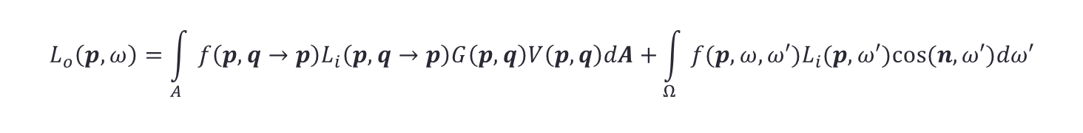


Separating Direct And Indirect Illumination
$$p′$$
$$p$$
$$p′′$$
direct illumination
indirect illumination
$$L_{o}\left(p,ω\right)=\int_{A}{f\left(p,q→p\right)L_{i}\left(p,q→p\right)G\left(p,q\right)V\left(p,q\right)dA+}\int_{Ω}{f(p,ω,}ω′)L_{i}(p,ω′)cos⁡(n,ω′)dω′$$

Slide 47
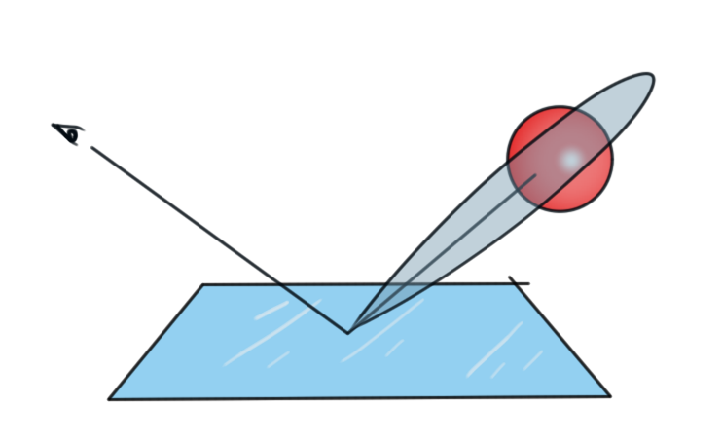
Importance Sampling
So far we have sampled incoming light uniformly over the hemisphere. Why is that a bad idea?
We want to shoot more samples where the function we are integrating is high!

Slide 48
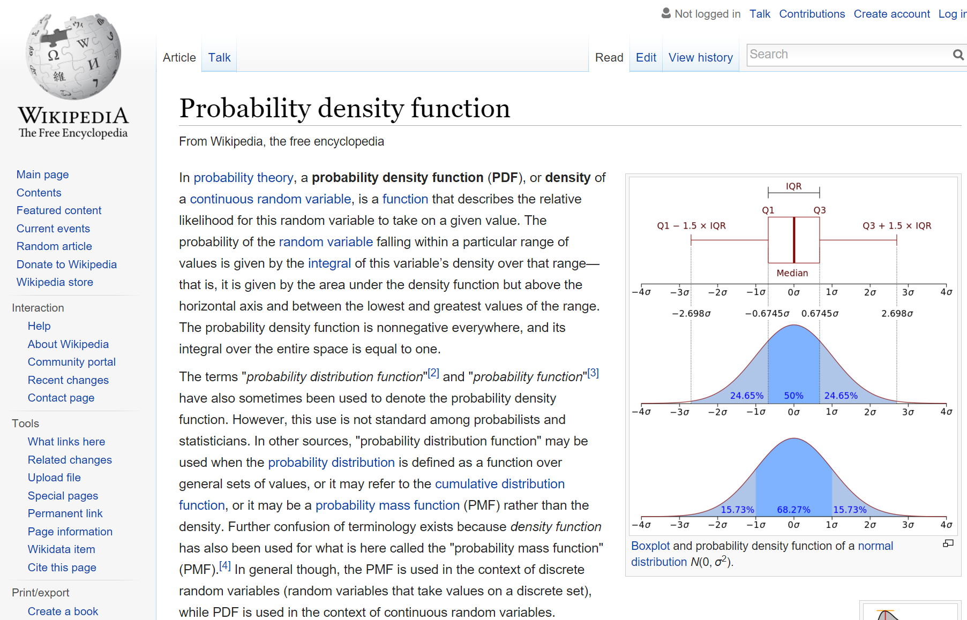
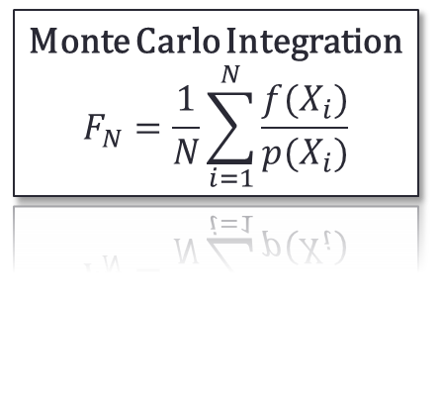
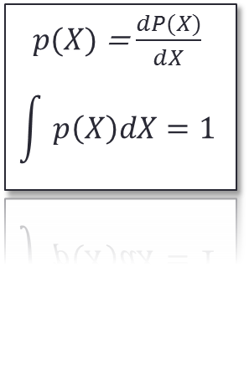
Probability Density Function
Monte Carlo Integration
$$F_{N}=\frac{1}{N}\sum_{i=1}^{N}{\frac{f(X_{i})}{p(X_{i})}}$$
$p(X)$ = $\frac{dP(X)}{dX}$
$$\int{p\left(X\right)dX=1}$$

Slide 49
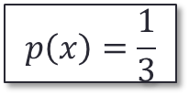
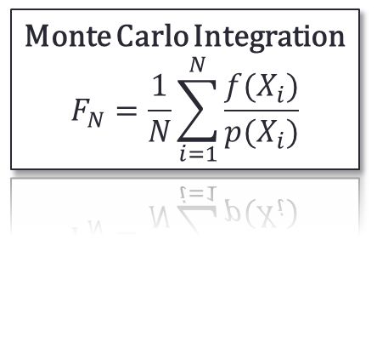
Importance Sampling
Monte Carlo Integration
$$F_{N}=\frac{1}{N}\sum_{i=1}^{N}{\frac{f(X_{i})}{p(X_{i})}}$$
4
$$p\left(x\right)=\frac{1}{3}$$
0
1
2
3

Slide 50




Importance Sampling
Monte Carlo Integration
$$F_{N}=\frac{1}{N}\sum_{i=1}^{N}{\frac{f(X_{i})}{p(X_{i})}}$$
$$p\left(X\right)=\frac{2}{3}$$
$$p\left(X\right)=\frac{1}{6}$$
4
$$p\left(X\right)=\left\{\begin{matrix}\frac{1}{6} & 0<X<1 \\ \frac{2}{3} & 1<X<2 \\ \frac{1}{6} & 2<X<3\end{matrix}\right.$$
$$p\left(X\right)=\frac{1}{6}$$
0
1
2
3

Slide 51
Importance Sampling
Monte Carlo Integration
$$F_{N}=\frac{1}{N}\sum_{i=1}^{N}{\frac{f(X_{i})}{p(X_{i})}}$$
$$p\left(X\right)=\frac{2}{3}$$
$$p\left(X\right)=\frac{1}{6}$$
4
$$p\left(X\right)=\left\{\begin{matrix}\frac{1}{6} & 0<X<1 \\ \frac{2}{3} & 1<X<2 \\ \frac{1}{6} & 2<X<3\end{matrix}\right.$$
$$p\left(X\right)=\frac{1}{6}$$
0
1
2
3

Slide 52
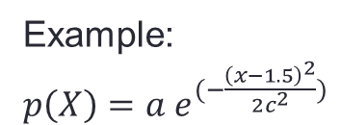
Importance Sampling
4
Example:
$p\left(X\right)=a e^{(−\frac{{\left(x−1.5\right)}^{2}}{2c^{2}})}$
0
1
2
3

Slide 53



Importance Sampling
4
Example:
$p\left(X\right)=a e^{(−\frac{{\left(x−1.5\right)}^{2}}{2c^{2}})}$
$$f\left(x\right)=HIGH$$
$$\frac{f\left(x\right)}{p(x)}=HUGE$$
$$p\left(x\right)=LOW$$
0
1
2
3

Slide 55
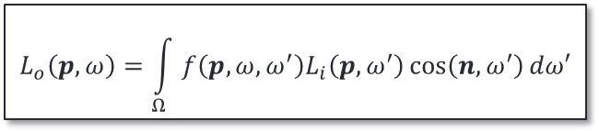
Importance Sampling
$$L_{o}\left(p,ω\right)=\int_{Ω}{f\left(p,ω,ω^{′}\right)L_{i}\left(p,ω^{′}\right)\cos\left(n,ω^{′}\right)dω′}$$
When evaluating the Rendering Equation, we do not know the function we want to integrate
  Since it depends on the incoming light over the hemisphere
  But we do know the BRDF, so we importance sample on that

Slide 57
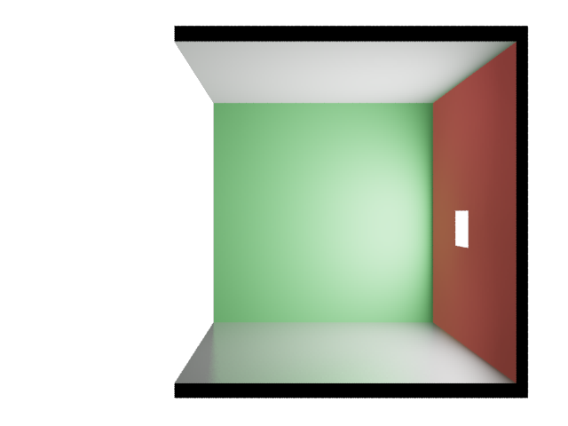

Multiple Importance Sampling
$$p$$

Slide 58
Multiple Importance Sampling
$$p$$

Slide 59
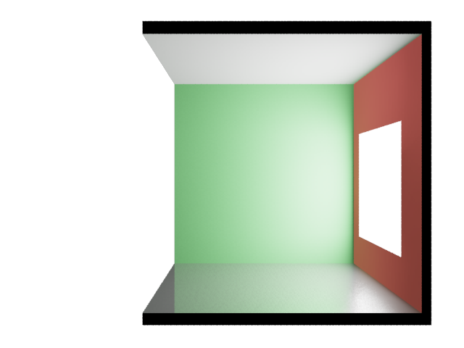
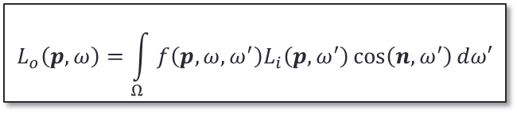
Multiple Importance Sampling
Low p(x), high f(x)
$$p$$
$$L_{o}\left(p,ω\right)=\int_{Ω}{f\left(p,ω,ω^{′}\right)L_{i}\left(p,ω^{′}\right)\cos\left(n,ω^{′}\right)dω′}$$

Slide 60
Multiple Importance Sampling
$$p$$
$$L_{o}\left(p,ω\right)=\int_{Ω}{f\left(p,ω,ω^{′}\right)L_{i}\left(p,ω^{′}\right)\cos\left(n,ω^{′}\right)dω′}$$

Slide 61
Multiple Importance Sampling
Low p(x), high f(x)
$$p$$
$$L_{o}\left(p,ω\right)=\int_{Ω}{f\left(p,ω,ω^{′}\right)L_{i}\left(p,ω^{′}\right)\cos\left(n,ω^{′}\right)dω′}$$

Slide 62
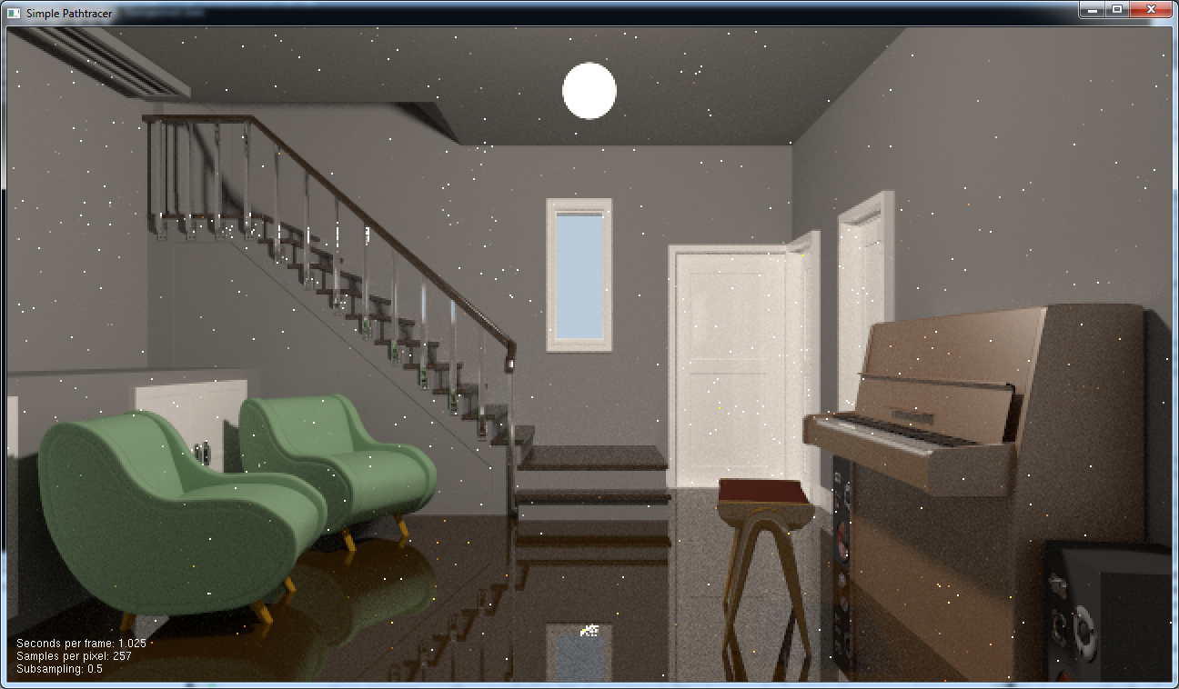
Multiple Importance Sampling

Slide 63
Multiple Importance Sampling

Slide 64
Multiple Importance Sampling

Slide 65
Multiple Importance Sampling

Slide 66
Multiple Importance Sampling

Slide 67
Multiple Importance Sampling

Slide 68
Multiple Importance Sampling

Slide 69

Multiple Importance Sampling
Need to estimate:
$$\int{f\left(x\right)g\left(x\right)dx}$$
Could Use:
$0.5\left(\frac{f\left(X\right)g\left(X\right)}{p_{f}\left(X\right)}+\frac{f\left(Y\right)g\left(Y\right)}{p_{g}\left(Y\right)}\right)$?

Slide 70
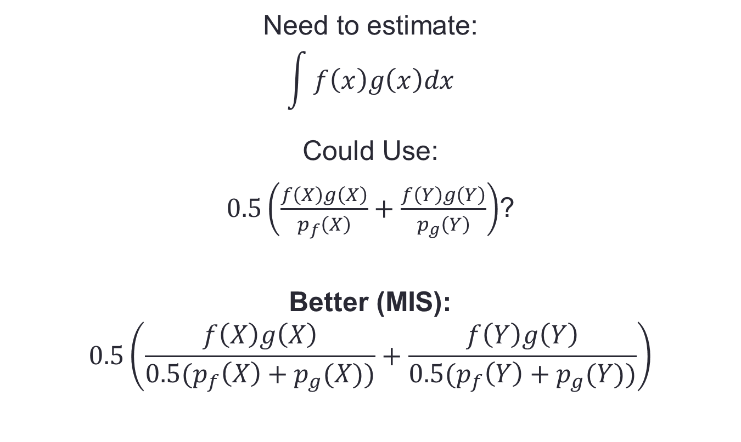
Multiple Importance Sampling
Need to estimate:
$$\int{f\left(x\right)g\left(x\right)dx}$$
Could Use:
$0.5\left(\frac{f\left(X\right)g\left(X\right)}{p_{f}\left(X\right)}+\frac{f\left(Y\right)g\left(Y\right)}{p_{g}\left(Y\right)}\right)$?
Better (MIS):
$$0.5\left(\frac{f\left(X\right)g\left(X\right)}{{0.5(p}_{f}\left(X\right)+p_{g}(X))}+\frac{f\left(Y\right)g\left(Y\right)}{{0.5(p}_{f}\left(Y\right)+p_{g}(Y))}\right)$$

Slide 71
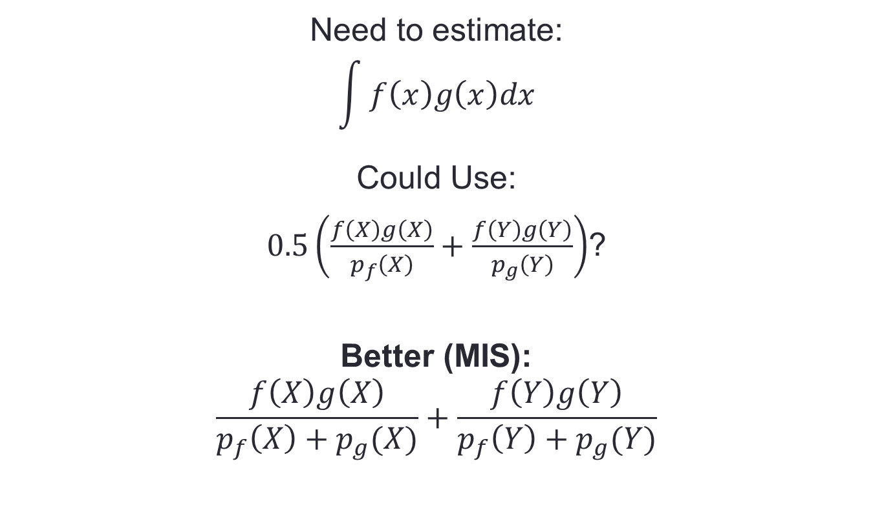
Multiple Importance Sampling
Need to estimate:
$$\int{f\left(x\right)g\left(x\right)dx}$$
Could Use:
$0.5\left(\frac{f\left(X\right)g\left(X\right)}{p_{f}\left(X\right)}+\frac{f\left(Y\right)g\left(Y\right)}{p_{g}\left(Y\right)}\right)$?
Better (MIS):
$$\frac{f\left(X\right)g\left(X\right)}{p_{f}\left(X\right)+p_{g}(X)}+\frac{f\left(Y\right)g\left(Y\right)}{p_{f}\left(Y\right)+p_{g}(Y)}$$

Slide 72
Multiple Importance Sampling

Slide 73
Multiple Importance Sampling

Slide 74
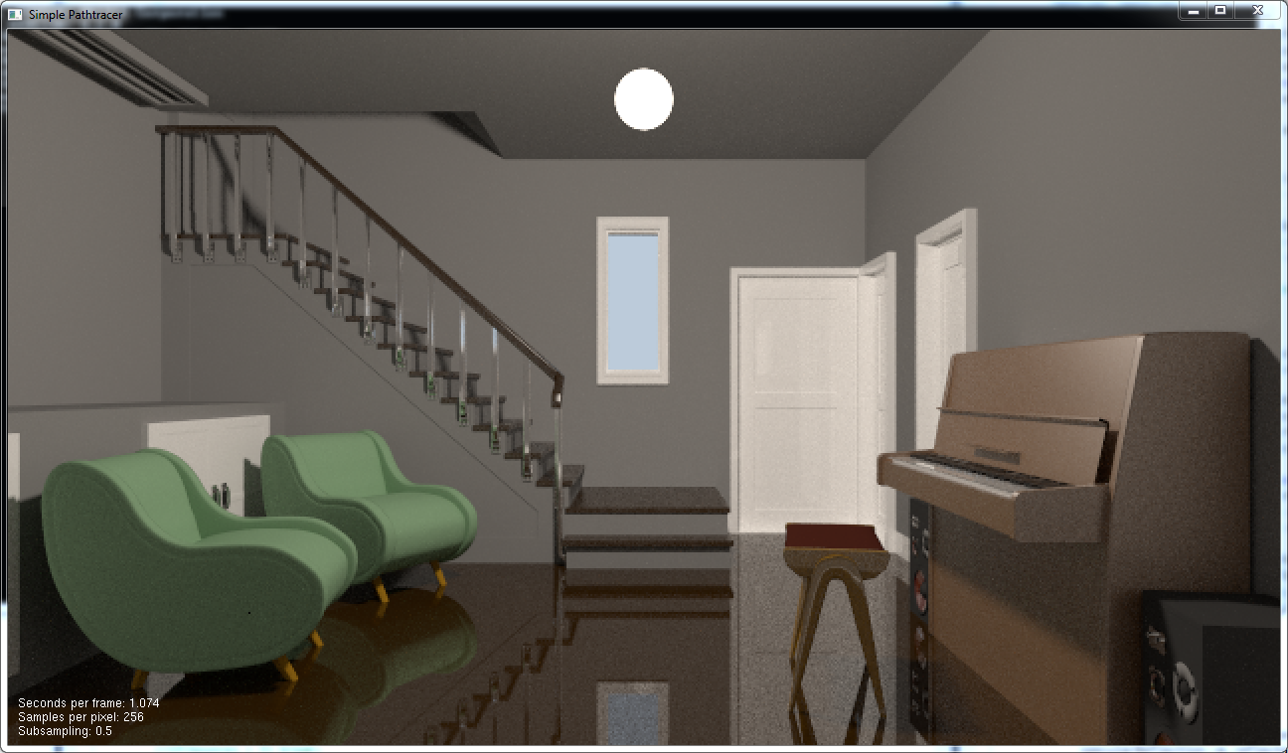
Multiple Importance Sampling
Do both!
Sample brdf first
Then light
PDF of this sampling strategy is (weighted) sum
- Only very low if neither technique is likely to choose dir
$$p$$

Slide 75
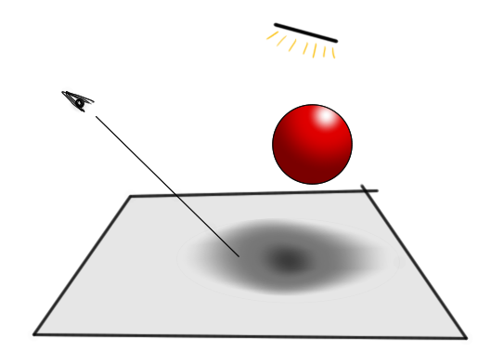
Stratified Sampling
Another standard variance reduction method
When just choosing samples randomly over the domain, they may “clump” and take
a long while to converge
It will converge to 0.5
after unlimited time.
But after four samples I still
have prob=1/8 that the pixel
will be considered all in shadow
or completely unshadowed

Slide 76
Stratified Sampling
Divide domain into “strata”
  Don’t sample one strata again until
  all others have been sampled
  once.

Slide 77
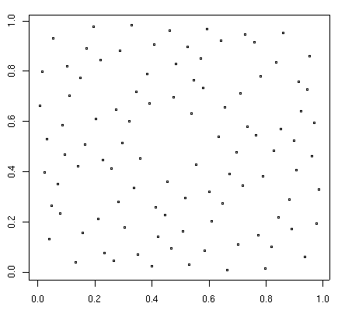
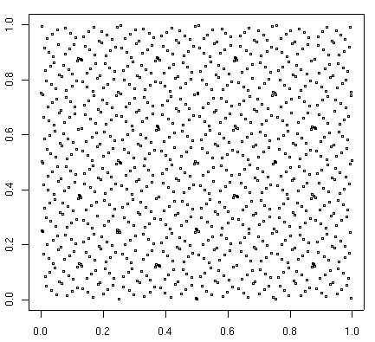
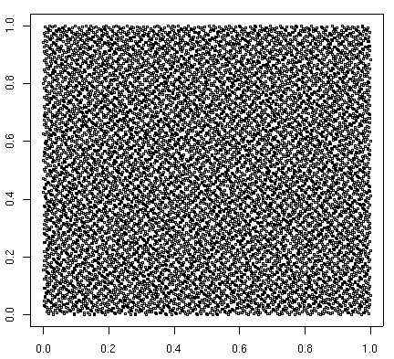
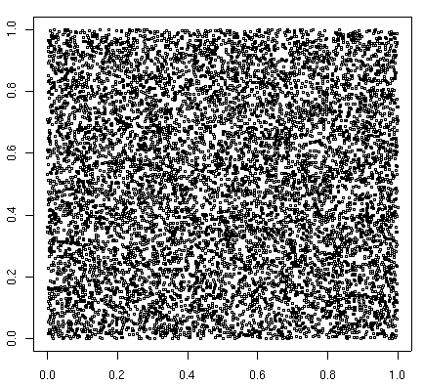
Stratified Sampling
If we know how many samples we want to take, we can get good stratification from “jittering”
If not, we want any sequence of samples to have good stratification. We can use a Low Discrepancy Sequence
SOBOL: 100 samples
SOBOL: 1000 samples
SOBOL: 10000 samples
RANDOM: 10000 samples

Slide 78
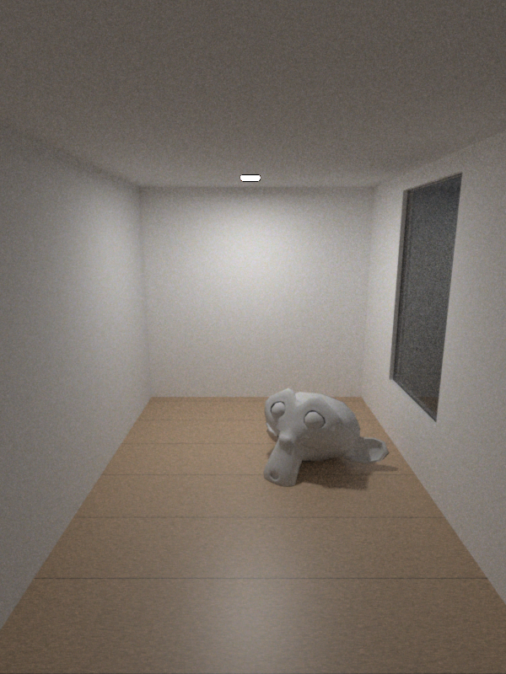
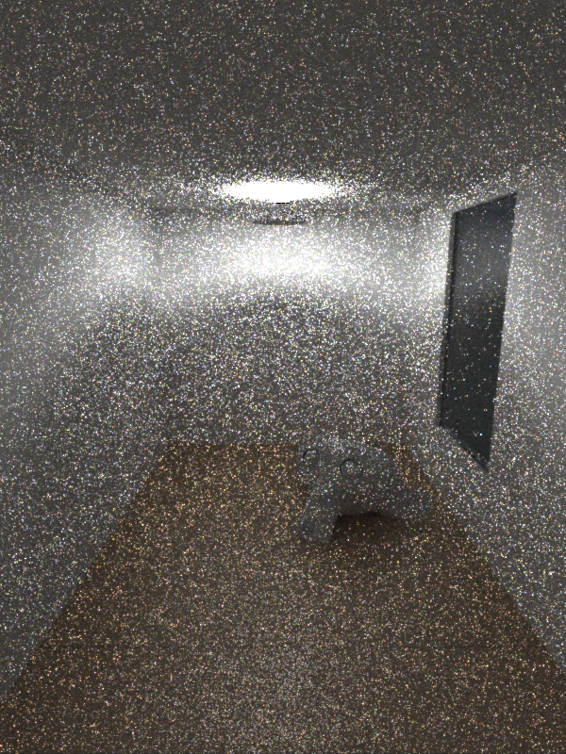
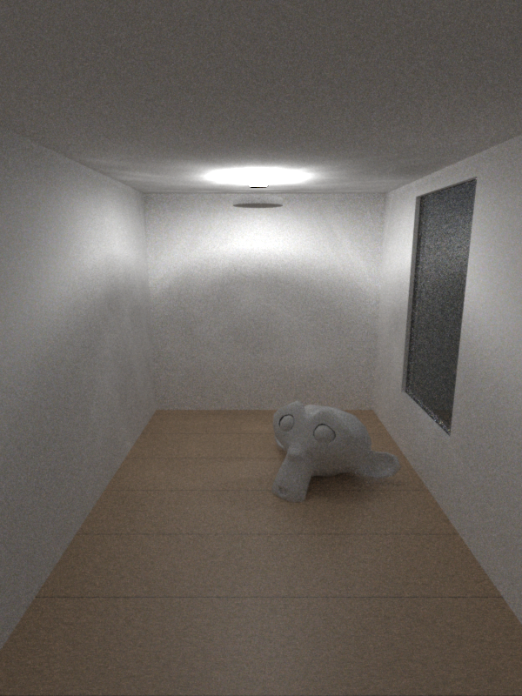
Are we done yet?
Pathtracing 3m
Pathtracing 3m
Bidirectional Pathtracing 3m

Slide 79
Pathtracing

Slide 80
Bidirectional Pathtracing

Slide 81
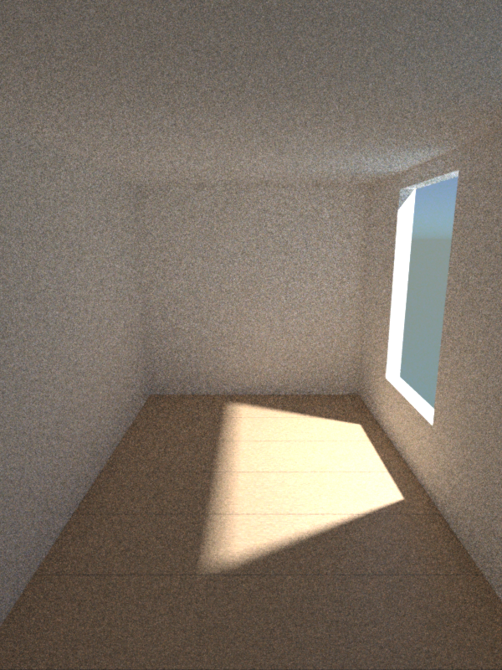
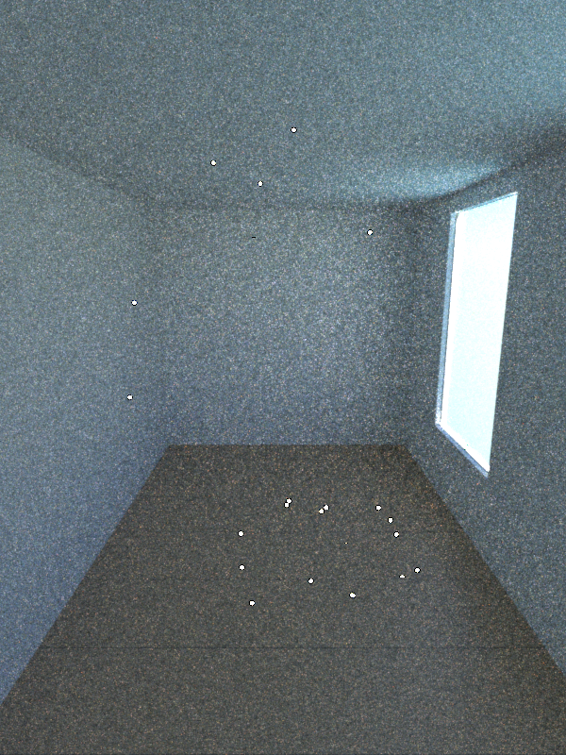

Bidirectional Path Tracing
Pathtracing 3m
Pathtracing 3m
Bidirectional Pathtracing 3m

Slide 82


Pathtracing 75SPP (~5min)
Bidirectional Pathtracing 45SPP (~5min)

Slide 83



Are we done yet?
Bidirectional Pathtracing 30m
Bidirectional Pathtracing 30m
Metropolis Light Transport 30m

Slide 84

Metropolis Light Transport

Slide 85
Metropolis Light Transport

Slide 86
Metropolis Light Transport

Slide 87



Bidirectional Path Tracing
BD 5m
BD 2h
BD 19h 4m 12240 SPP

Slide 88



Metropolis Light Transport
MLT 5m
MLT 2h
MLT 17h35m, 9300 SPP

Slide 89


Bidirectional Path Tracing
5min
25min
1h15min

Slide 90



Metropolis Light Transport
5min
25min
1h

Slide 91



Further Reading
Pathtracing Lab

